Slide 1


Credit Risk Evaluation
Asad aftab
Data scientist
Credit One

Slide 2

PROJECT GOALS
Define the problem
Analyze the input data
How the data will be handled, stored and managed
Propose a well defined data science framework for this project
Reasons for choosing the framework
Flow chart the framework for visualization purpose
Data insights and known issues

Slide 3

THE PROBLEM
Credit One is a credit review and approval company, it has a set of partners that issue credit / loans and relies on Credit One customer rating process.
Lately there has been an increase in the number of the defaulting customers that were approved by Credit One originally.
This has caused management concern and prompted them to initiate this study for the credit approval process to be reviewed, scrutinized and tightened.
Data has been provided on the payment history and customer profile of the current customers to analyze and build a profile that will help filter new and current customers to be sure of their credit viability.

Slide 4

INPUT DATA
The input data comes as a csv file containing consumer credit data and their profile for e.g. age. The following fields are included:
Gender, age, marital status, education
Amount of granted credit
History of past monthly payments
Repayment status
Amount of monthly bill statements
Amount of previous monthly payments
Client default status (Y/N)

Slide 5

DATA HANDLING AND MANAGEMENT
The data will be copied from the assignment repository to the data scientist computer local storage
The storage is protected by a user and password login information
The data does not contain any personal information for e.g. names, ID numbers, addresses etc.
The local data will be deleted after the completion of the assignment or kept depending on the permission / agreement from the client.

Slide 6

DATA SCIENCE FRAMEWORK CHOSEN
The Data Science team at Credit One looked at several data science frameworks and chose to use BADIR which can be broken down to following steps:
Business question
Analysis plan
Data collection
Insights
Recommendation

Slide 7

1. BUSINESS QUESTION
What is the stated business question?
Business wants to know how we can predict the consumer’s credit viability and that the consumer will not be defaulting in the near future?
What is the intent underlying the question?
The intent is to save Credit One reputation as the approved consumers that have defaulted are on the rise. In doing so Credit One is likely to retain its credit / loan giving partners. If the issue is not resolved, there is a risk of losing partners..
What business considerations are likely to impact the analysis?
Timeline for the project, budget and availability of project resources. Other considerations to be clarified with the management.

Slide 8
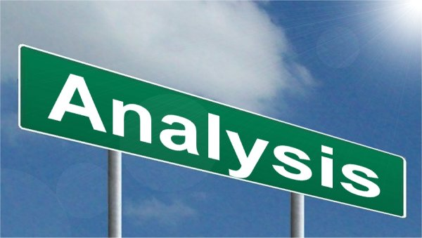
2. ANALYSIS PLAN
What is the analysis goal?
To find insights on the defaulted consumers and develop predictive modeling so that future defaulters can be predicted with accuracy.
What hypotheses are to be tested?
In general typical machine learning techniques will be applied for training and testing, any specific hypotheses or expectations will be clarified with the management in the subsequent phase of the project.
What data is required/available to test the hypotheses?
Credit data for 30,000 missed consumers (defaulted and non-defaulted) has been provided by the client and is already available for this assignment.
What methodology(-ies) will you employ?
Several machine learning models will be employed, compared and the best one will be selected. Further details will be sorted out in the next phases of the project.
What is the project plan (timeline and milestones, risks, phasing, prioritization, …)?
Project timeline is one month, risk assessment with stakeholders and project resources is being scheduled. Prioritization discussion is pending with the management.

Slide 9

3. DATA COLLECTION
From where can the data be obtained?
Data has already been downloaded from the client’s repository and is available for analysis.
How must the data be cleansed and validated?
Data will first be visually inspected for obvious error and formatting issues, then it will be loaded into Python Jupyter notebook environment where programming functions as well as visualizations will be applied to ensure it’s integrity and that it is ready for processing.

Slide 10

4. INSIGHTS
What patterns do you see in the data?
To be find and documented in the next phase of the project.
Are each of the hypotheses proven or disproven?
To be find and documented in the next phase of the project.
How much confidence should stakeholders place in the results?
We will capture the accuracy for each model and will address this item in the final report.
How do you rank your findings in terms of quantified impact on the business?
To be addressed in the next phase of the project.

Slide 11

5. RECOMMENDATION
Recommendations
To be documented in the final report.
Key insights with impact
To be documented in the final report.
Next steps
To be documented in the final report.

Slide 12

REASONS FOR CHOOSING BADIR FRAMEWORK
Since we are addressing a business problem BADIR will help us address the key questions as well as address the stakeholders concerns.
The team also reviewed other frameworks but found them oriented for technical issues and problems.
In the timeframe allocated for this project the team felt that it will be most efficient to use BADIR as it focusses on the business issues at hand without going into too much technical details which is well suited here since the audience belongs to the business management.

Slide 13
BADIR FRAMEWORK FLOW CHART
Start
Business Question
Question
Considerations
Intent
Analysis Plan
Goal
Methodology
Hypotheses
Project Plan
Data
Data Collection
Data
Cleaning
Validation
Insights
Patterns
Results
Findings
Confidence
Results acceptable?
Yes
Recommendation
Next Steps
Insights
No
End

Slide 14

DATA INSIGHTS AND KNOWN ISSUES
Upon visual inspection data for 30,000 consumers has been provided.
The data shows customer profile details excluding any personal or identification information.
Six months of billing and payment history is included.
Dependent variable of default or no default is provided.
No missing values or other issues identified via visual inspection.
In the next phase of the project the data will be loaded in the environment and analyzed programmatically and any issues, insights will be reported.

Slide 15

Thank
you

